Slide 1
ENSE 470 Milestone 3
Jeremy Cross
Iden Ellia
Abdullah Alasmari

Slide 2
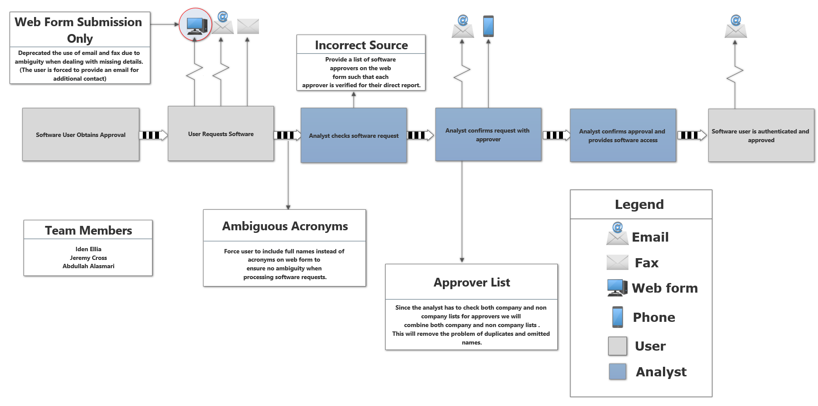
Recall, future state VSM

Slide 3
Changes & Misc.
Have your plans changed since your group’s initial conception and project evolution
We changed how we handled the acronyms, we now allow the user to either select from a list of software programs or search for the desired program
When requesting approval, the request will either automatically be sent to any of the approvers for that software or the user can manually select with approver they would like.

Slide 4
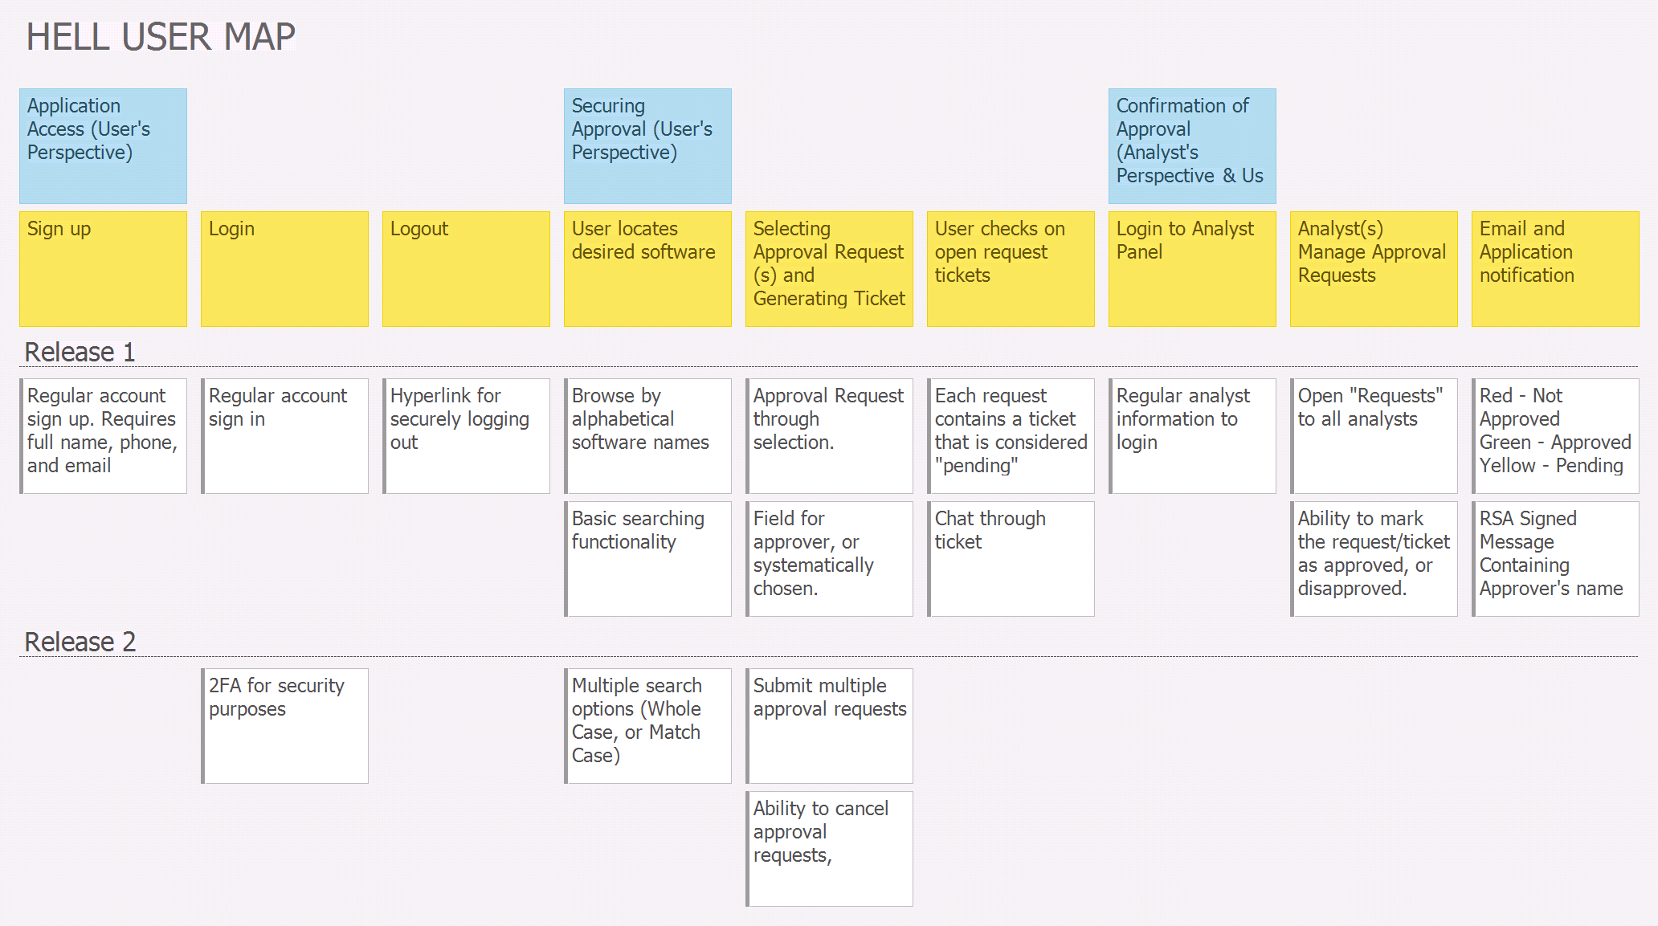
User Story Map

Slide 5
Group reflection
How did you feel about this milestone? What did you like about it? What did you dislike?
Its interesting creating a road map to follow when developing software
What did you learn about yourself as you collaborated and worked through this milestone?
We learned how to take the ideas that we generated from our future state diagram and incorporate them into our user story map.
How to breakdown and determine the order of our activities as well determining the priority of our functionality
How will you use what you have learned going forward?
We will use the user story map that we created to develop milestone 4.
What “stuff & things” related to this milestone would you want help with?
It was a bit challenging breaking our ideas down for our user map.

